Slide 1
Teach reading: change lives
Parent workshop: Phonics and early reading

Slide 2
A love of reading is the biggest indicator of future academic success.
OECD (The Organisation for Economic Co-operation and Development)

Slide 3




How many times have you already read today?
Reading is a very vital skill.

Slide 4

Phonics

Slide 5

Little Wandle Letters and Sounds Revised
Our school has chosen
Little Wandle Letters and Sounds Revised as our systematic, synthetic phonics (SSP) programme to teach early reading and spelling.

Slide 6
Phonics is:
making connections between the sounds of our spoken words and the letters that are used to write them down.
Notes:
It sounds complicated but it really isn’t!

Slide 7

Blending to read words
The children must sound out each letter then blend to say the word.

Slide 8
Terminology
You will hear you children using these words.
Phoneme
The smallest unit of sound in a word. E.g. /i/m/oo/ur/
Digraph
Two letters which together make one sound (phoneme)
E.g. /ee/ ay/ ow/
Grapheme
A written letter or group of letters to show how the phoneme is written.
E.g. /t/r/ie/ay/
Trigraph
Three letters which together make one sound (phoneme)
E.g. /igh/air/ ear/

Slide 9
Terminology
Blend
To combine individual phonemes into one continuous stream of sound to make a whole word.
E.g. s-n-a-p, blended together, reads ‘snap’
Split vowel digraph
A digraph representing a vowel sound where its two letters are split by an intervening consonant.
E.g. ‘a-e’ in ‘take’
Segment
To break down a word into its individual phonemes.
E.g. ‘ship’ can be segmented as sh-i-p

Slide 10


Teaching order
The children are taught the sounds in a particular order.

Slide 11


Gradually your child learns the entire alphabetic code:

Slide 12


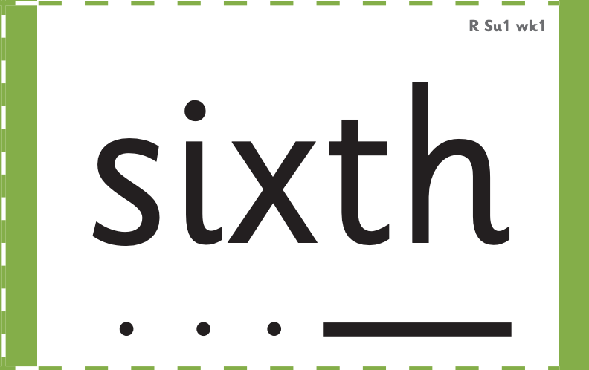



How we make learning stick
The teachers use specific resources to ensure every class is taught in the same way. We use grapheme cards and word cards.

