Slide 1
Teach reading: change lives
Parent workshop: Phonics and early reading

Slide 2
A love of reading is the biggest indicator of future academic success.
OECD (The Organisation for Economic Co-operation and Development)

Slide 3




How many times have you already read today?
Reading is a very vital skill.

Slide 4

Reading and spelling

Slide 5


Reading and spelling
The children will learn that a grapheme can make different sounds in different words.

Slide 6
The children will learn all the different ways to write a phoneme for example sh:
shell
chef
special
caption
mansion
passion

Slide 7
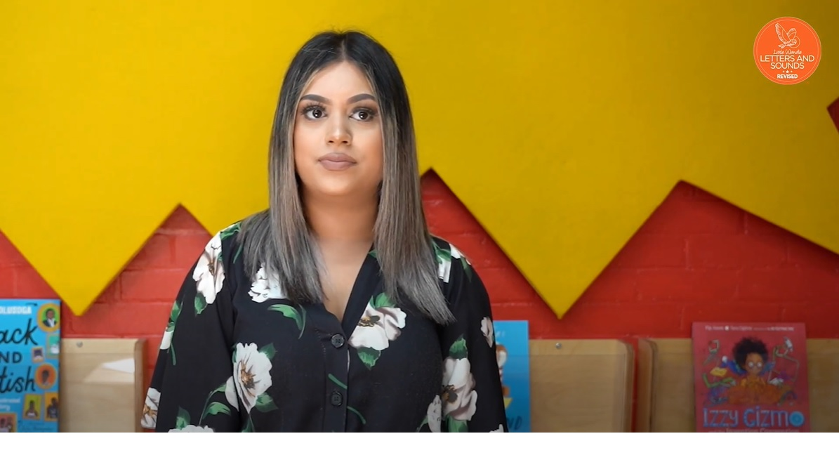
Tricky words- e.g. we, the, was
The children will identify the tricky part of the word.

Slide 8

Spelling
The children are taught to do the following:
Say the word.
Segment the sounds.
Count the sounds.
Write them down.

Slide 9
How do we teach reading in books?
Reading practice sessions are:
timetabled two times a week
taught by a trained teacher/teaching assistant
taught in small groups.

Slide 10

We use assessments to match your child to the right level of book

Slide 11

Reading a book at the right level
This means that your child should:
Know all the sounds and tricky words in their phonics book well.
Read many of the words by silent blending (in their head) – their reading will be automatic.
Only need to stop and sound out about 5% of the words by the time they bring the book home – but they should be able to do this on their own.

Slide 12
Reading at home

Slide 13
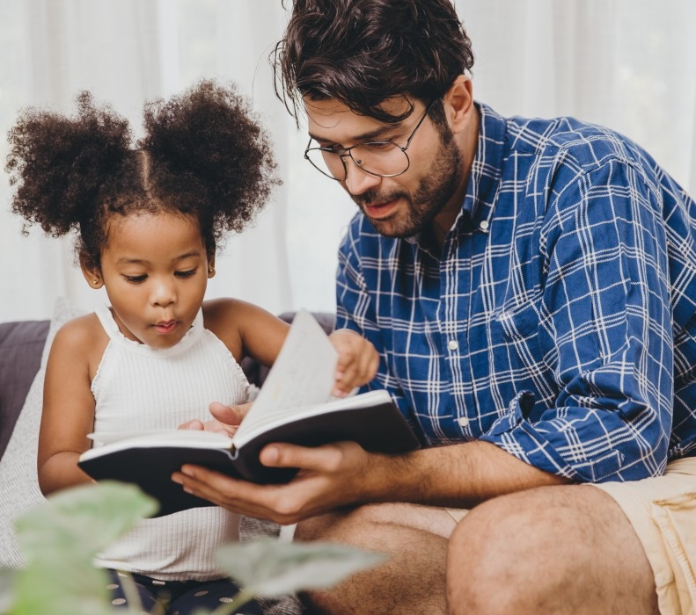
The most important thing you can do is read with your child
Reading a book and chatting had a positive impact a year later on children’s ability to…
understand words and sentences
use a wide range of vocabulary
develop listening comprehension skills.
The amount of books children were exposed to by age 6 was a positive predictor of their reading ability two years later.
Parental involvement in the development of children’s reading skills: A five-year longitudinal study (2002) Senechal, M. and Lefvre, J

Slide 14

Books going home phonics book sharing book

Slide 15
Listening to your child read their phonics book
Your child should be able to read their book without your help.
If they can’t read a word encourage them to sound it out and blend. If they are still unsure read it to them.
Talk about the book and celebrate their success.

Slide 16

Supporting your child with phonics
For more information and videos to watch please go to: www.littlewandlelettersandsounds.org.uk/resources/for-parents/

Slide 17

Read to your child
The shared book is for YOU to read:
Make the story sound as exciting as you can by changing your voice.
Talk with your child as much as you can:
  Introduce new and exciting language
  Encourage your child to use new vocabulary
  Make up sentences together
  Find different words to use
  Describe things you see.

Slide 18
One of the greatest gifts adults can give is to read to children
Carl Sagan

