Slide 1

Zones of Regulation
A framework to develop emotion regulation skills in children
Kenmore Park Infant School Parent Workshop
Notes:
Introductions (Clinicians and MHST)

Slide 2
Group Agreement
Respect that we all think and experience things differently
Confidentiality
Ask questions – let’s chat!
Leave the space quietly if needed (toilet/refreshment breaks, phone calls)
Follow school policy in the event of a fire drill

Slide 3
Session Objectives
Introduction to Zones of Regulation
Window of Tolerance
Identifying Behaviours in Different Zones
Misconceptions and Implementation
Impact of Zones on others
Modelling Zones of Regulation
Practical skills
Let’s talk! Reflective Space
Notes:
Come back to

Slide 4
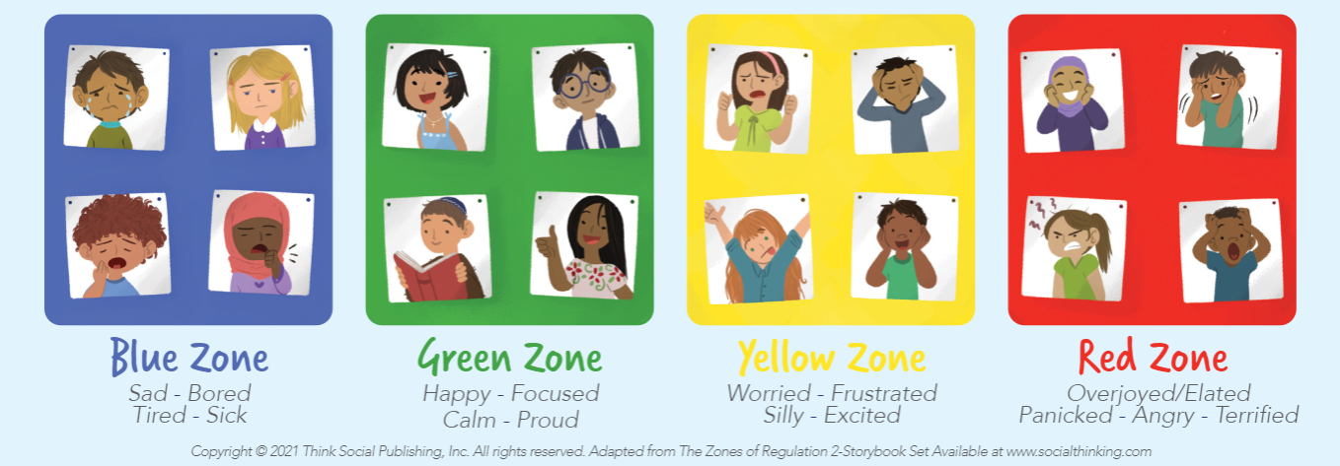
What are the Zones?
Activation levels in our bodies from low-energy to high-energy states
These activation levels correspond with emotions from sad to extremely happy/angry
Notes:
L

Slide 5
Window of Tolerance
Notes:
Depending on stimulation from the environment and our emotional states, we move across the levels
We can use strategies to take control of moving across these levels to return to the Green Zone if needed
Move hypoarousal to blue
Come back to

Slide 6
Behaviours you may notice
Blue Zone
Easily upset
Appearing tired
Crying
Poor concentration
Refusing to talk
Poor appetite
Sluggishness
Green
Able to communicate calmly
Relaxed
Focused
Impulse control
Engages in activities independently
Yellow
Constantly seeking reassurance
Complaining of aches and pains
Breathing fast
Clenching fists
Poor appetite
Fidgeting, moving around, being silly
Red
Throwing objects
Emotional outbursts
Hitting
Yelling
Crying
Running around
Laughing
Notes:
L Ask teachers what behaviours they notice in each zone
If it is not obvious for a child how they are feeling, notice the behaviour instead and prompt the child to notice their own behaviour to use it as a clue as to how they are feeling / which zone they are in.
These aren’t restricted to each zone, each child is different so you may see one behaviour in many zones. Behaviours are fluid.
Teacher’s examples

Slide 7
Body Cues
Blue Zone
Moving slowly
Heavy feeling in arms and legs
Slow heartbeat
Foggy / unclear thoughts
Green
Feeling focused
Not too hot, not too cold
Relaxed muscles
Smile on your face :)
Yellow
Thinking faster
Wiggling
Faster heartbeat
Muscles tensing up
Red
Body feeling hot in temperature
Fists and jaw clenched
Fast heartbeat
Muscles feeling tense
Notes:
L Ask teachers what body cues in each zone
These aren’t restricted to each zone, each child is different so you may see one behaviour in many zones.
Teacher’s examples

Slide 8
Why the Green Zone?
Can think clearly and behave safely
Useful zone for school
Context matters!
Green Zone = ‘middle energy level’
Focused and engaged
Notes:
S
Schools usually want children to be in green. But this is not always appropriate to be in green.

Slide 9
Misconceptions about the Zones
“Red is angry” – there are other emotional states that correspond with high energy, such as elation or terror
“Red is bad” - the zones aren’t good or bad. Only in certain situations it is not pleasant, appropriate, or practical to be in other zones than green
“We need calming strategies” - sometimes we actually have to increase our energy to return to the Green Zone
Notes:
L

Slide 10
Incorporating ZoR into the Classroom
Encourage them to describe how they feel using the corresponding zone colour
Create a ‘Regulation Station’ and regular check-ins
Introduce ZoR to your class before implementing it
Model self-regulation! What can you do when you’re in a challenging situation?
Making collaborative decisions about what child needs
Teach self-regulation strategies
Notes:
How are these being used at the moment?
Introduce: ZoR is not a punishment, it’s a form of communication to meet needs where the child is at.
Regulation station: Modify the classroom or learning space to support emotional regulation. Provide sensory tools like stress balls or fidget toys, designate quiet zones for calming activities, and display visual cues of the Zones for easy reference.
Foster emotional awareness: Begin by helping children recognise and identify their current emotional state. Encourage them to describe how they feel using the corresponding zone colour. For example, "I'm feeling really excited right now, so I'm in the Yellow Zone.“
Teach Self-Regulation Strategies
Each zone comes with a set of self-regulation strategies. For instance, deep breathing exercises, mindfulness activities, or taking a break can help children shift from the Red Zone to the Green Zone. Teach these strategies and practise them together.
Visual supports: Visual aids such as posters, charts, and flashcards can help children better understand and remember the Zones of Regulation. These visual supports serve as a constant reminder of the framework and its associated strategies.
Model Self-Regulation
As a teacher aide, you're a role model for the students. Demonstrate self-regulation techniques when faced with challenging situations. Narrate your own emotional experiences and how you manage them using the Zones.

Slide 11



Regulation Strategies “BREATHING”
BELLY BREATHING
BOX BREATHING
LIONS BREATH

Slide 12



Regulation Strategies “BODY-FOCUSED”
PALM PUSH
BODY SCAN
BUTTERFLY HUG

Slide 13








Regulation Strategies “GROUNDING”
5 SENSES
FIND YOUR HAPPY, SAFE SPACE
MIND GAMES

Slide 14
How might your Zone impact the class?
What happens to the energy in the classroom?
What happens to the behaviour of children?
How do you communicate?
Notes:
L
- Know what zones you are in and how this can impact the class
Think about what you can do to change zones
Know yourself and how you react in difficult situations

Slide 15
Modelling Zones of Regulation at Home
Identify your own feelings using the Zones
(e.g. “I’m frustrated. I think I am in the Yellow Zone.”)
Talk about what tool you will use to be in the appropriate Zone
(e.g. “I need to take four deep breaths to help get me back to the Green Zone.”)
Explain how using the tools helped you get back to the Green Zone
Share how behaviour at home is affecting your Zone.
(e.g. if they are in the Green Zone, you could comment that their behaviour is also helping you feel happy/go into the Green Zone.)
Notes:
Teacher suggestions – How can we model the Zones of regulation?
- It is important to remember to show the children how you use tools to get back to the green zones.

Slide 16
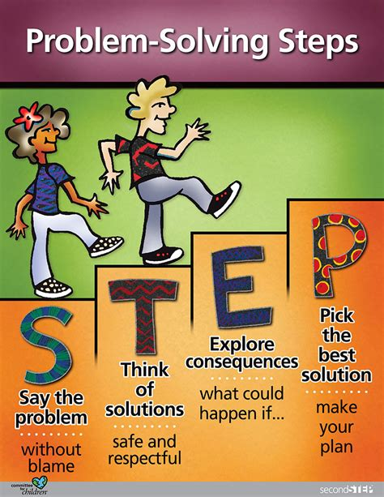
Problem solving
Notes:
Common problem in the classroom OR scenario

Slide 17
Common Questions about the Zones
Can children be in more than one zone at the same time?
Should children be punished for being in the RED Zone?
Can you look like one Zone on the outside and feel like you are in another Zone on the inside?
Notes:
Problem solving space

Slide 18
Feedback / Reflective Space
Notes:
Teacher questionnaire

Slide 19
Heading
Text
Text
Text
Text

Slide 20
Heading
Subheading
Text
Subheading
Text
Subheading
Text
Subheading
Text
Subheading
Text
Subheading
Text

Slide 21



Heading
Text
Text
Text
Text

Slide 22
Heading
Written and verbal feedback gained
Text
Text

Slide 23
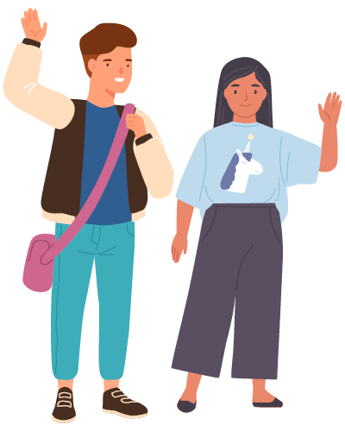
Questions/ final comment

Slide 24










Icons
These icons can be copy and pasted into your slides, choose ones that relate to the content of the slide
Find other icons by navigating to ‘Insert’ and then ‘Icons’ on the top bar

Slide 25
Other graphics
You can use these to brighten up any slides, just copy and paste them

